Slide 1
THE TITLE

Slide 2
Who’s presenting?
Mino
Yoon
Mimop
Hoon
Jinu

Slide 3
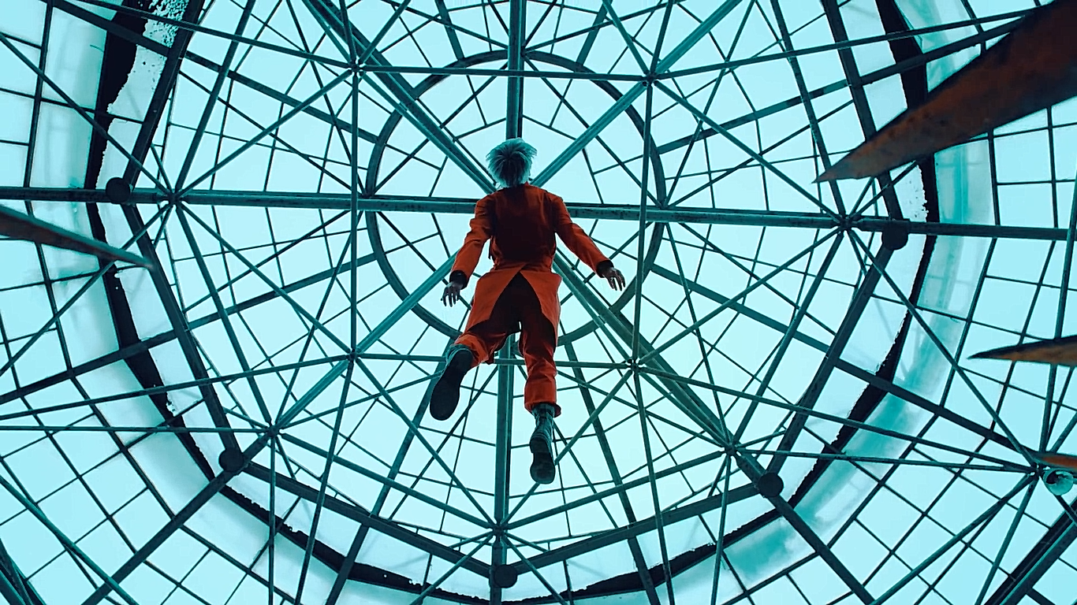
Group 4
Home
TV Shows
Movies
Latest
My List
Subject | subject | subject
The Title
This presentation is about the presentation is about presentation is about the presentation.
START

Slide 4

Group 4
Home
TV Shows
Movies
Latest
My List
THE TITLE
THE TITLE
This presentation is about the presentation is about presentation is about the presentation. This presentation is about the presentation is about presentation is about the presentation.

Slide 5

Group 4
Home
TV Shows
Movies
Latest
My List
THE TITLE
THE TITLE
This is point number one
This is point number two
This is point number three
This is no point

